Slide 1
Mediation in the Asia Pacific region: Opportunities & Challenges
7th Asia Pacific Mediation Forum Conference,
‘Synergizing Eastern and Western Constructs of Mediation towards Better Understanding’, Lombok, West Nusa Tenggara, Indonesia, 10-12 February 2016
Dr Dale Bagshaw
BA, DipSocStud, Msoc Admin, PhD
Adjunct Associate Professor
University of South Australia

Slide 2
A ‘post’ modern view of the world
Firstly:
...we are living in a world of flux and transition; the old is crumbling and fading yet the new is still indistinct and ambiguous;
secondly, ‘post’ can also refer to a world in which the old and the new co-exist:
Here the present has many contents, many different political, cultural and economic experiences, many conflicting and unstable social and institutional alliances, many levels of personal and collective action
Penna & O'Brien, 1996, p.40

Slide 3
We are roughly 4-5 decades into the recent, largely Western, history of mediation
Enormous shifts in people’s lives and conditions during this time include:
increasing globalisation
waves of mass migration (refugees, economic migrants)
whole scale urbanisation and Westernisation
trans-national civil rights movements
the universalisation of “the market”
an emphasis on economic rationalism and managerialism

Slide 4
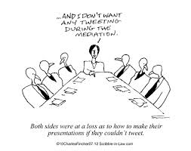
Shifts over the past 4 decades
the development of new service industries
rapid technological changes
fast growth and increased use of the internet and social media
widespread travel
major increase in the global population
rapidly ageing populations
growth and acceptance of new life-styles

Slide 5
Shifts over the last 4 decades
increasingly complex and diverse family relationships, lifestyles and financial arrangements
the global spread of life-threatening diseases such as AIDS
profound change in the nature of global conflicts – complex internal conflicts due to failed or collapsing states
transnational threats e.g. terrorism and organised crime
increasing global pollution, global warming, changing climates and
rapidly depleting global resources – 86% of the world is in ecological debt, with increased inequality between countries.

Slide 6
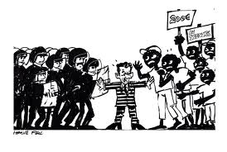
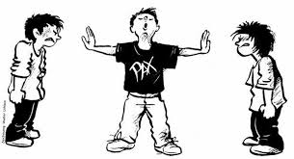
These changes have opened up and will continue to open new markets for mediators, for example:
Court-annexed mediation
Public policy mediation
Environmental mediation
Peace mediation
Cross-cultural mediation
Victim-Offender Mediation
Peer mediation
Elder mediation
Child-inclusive mediation
Online dispute resolution

Slide 7
Mediation styles, models or approaches
In the 1960s and 70s there was only one Western style - facilitative mediation
Now there is a huge range of styles, often based on the professional background/
paradigms of the mediator
Expert advisory mediation
Evaluative mediation
Settlement mediation
Interest-based mediation
Solution-based mediation
Transformative mediation
Narrative mediation
Insight mediation
Mindful mediation
Therapeutic mediation
Tradition-based mediation
Wise-counsel mediation ………….. etcetera

Slide 8
Mediation skills are present in different approaches to conflict, sometimes reflecting different ends by similar means, for example:
Mediation in different forms has been practiced in most Asian and Pacific cultures for long spans of history.
Western mediators tend to think they have just discovered or invented it.
Synergising Western and Eastern approaches to mediation, blending the best of each, has been an important theme in our APMF conferences.
Facilitation
Consensus-building
Cooperative governance
Collaborative leadership
Collaborative law
Deliberative democracy
Civic dialogues
Family conferencing
Settlement weeks
Joint fact finding

Slide 9
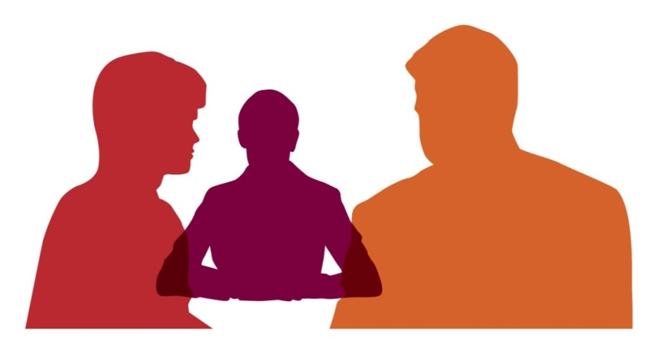
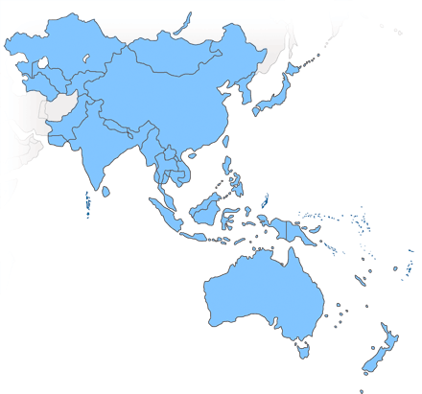
Mediation in the world has a long history, the practice of which falls along a spectrum that defies strict definition

Slide 10
Traditional mediation practices
In many countries and cultures, including those in the Asia Pacific region, there is a longstanding history of informal conflict resolution practices involving intermediaries or third parties.
Some traditional practices are similar to approaches that Westerners define as mediation where the parties make their own decisions, others are more like arbitration, where the third party (e.g. a Chief or Elder) makes the decision or reflects the consensus view.

Slide 11
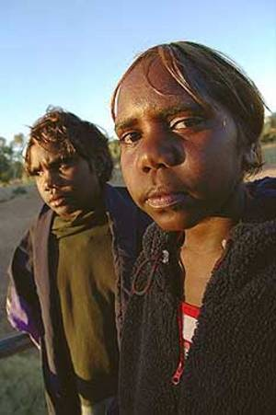
Australian and NZ indigenous communities and many other indigenous groups in the Asia-Pacific region are more likely use an approach which:
involves the broader extended family and/or community
uses indirect or circular communication
focuses on restoring harmony
is holistic
is concerned with face-saving
values the restoration of relationships
relies on a respected elder as mediator
is conducted in open spaces, often outside

Slide 12
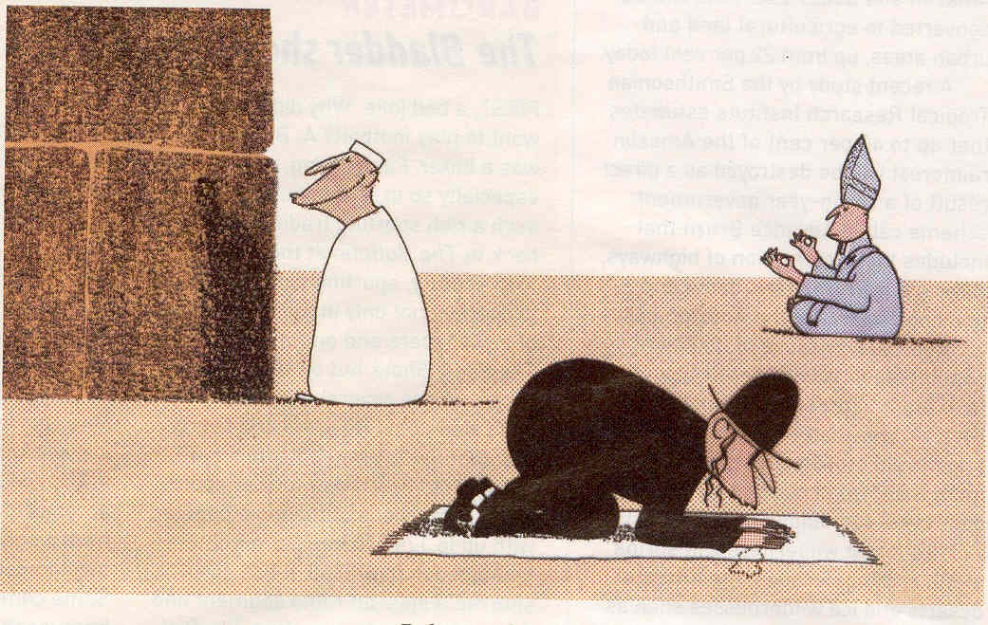
Mediation and Religion
Traditional or customary mediation practices are
often grounded in
religious principles e.g. Islamic , Confucian, Christian,
Hindu, Buddhist, Jewish
etc

Slide 13
Western forms of mediation, developed in the 1960’s, originated in the US.
1st Australian National Mediation Conference in Adelaide, South Australia, 1993
1st International Mediation Conference in Dublin, Ireland, 1993
1st World Mediation Forum in Spain, 1995
2nd International Mediation Conference in Adelaide, South Australia in 1996
1st Asia Pacific Mediation Forum Conference, Adelaide, South Australia, 2001.

Slide 14
Factors contributing to the increased interest in mediation in legal systems:
Inability of the courts to deal with the increasing load of cases
Long court delays
Scarce resources (e.g. legal aid)
Rising cost of litigation
Uncertainty of adjudicated outcomes
The need to preserve ongoing relationships
People choosing to stay in control of their conflict or dispute and its resolution
Privacy to avoid public humiliation or to save face
Mediation is more in keeping with some of the traditional/cultural ways of resolving conflicts.

Slide 15

In some countries in the world judicial systems are either non-existent, corrupt or suffer from …
insufficient institutional resources
outdated procedures
excessive adversarial, lengthy
and costly trials
unenforceable judgements
court backlogs

Slide 16
Western Approaches to Mediation
There are many Western models of mediation, however practices are dominated by problem solving and interest based approaches. From this perspective conflict and disputes are assumed to occur because people do not always share similar:
interests
needs
goals
understandings
resources
values

Slide 17

“Mediation is a process in which the parties to a dispute, with the assistance of a dispute resolution practitioner (the mediator), identify the disputed issues, develop options, consider alternatives and endeavor to reach an agreement.”

Slide 18
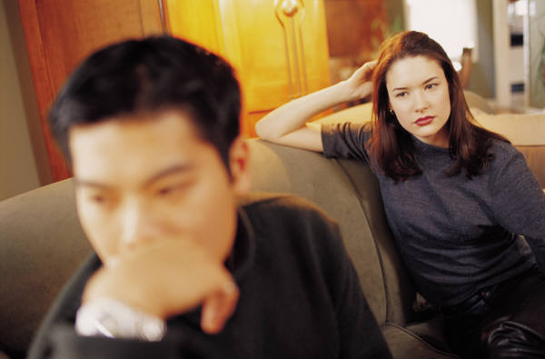
A focus on individual interests or needs does not take into account the needs and interests of the collective, or the structural inequities in the broader social context.
It may not be possible for parties to share world views or find common interests where there are conflicts involving differing values or beliefs.

Slide 19
Challenges for mediators today
It is essential that mediators design models of mediation to fit the cultural, individual and collective needs of their clients, rather than force their clients to follow a particular model or approach imposed by the mediator
Mediators also need to be concerned with issues of justice and human rights or mediation will be discredited as a dispute resolution approach

Slide 20
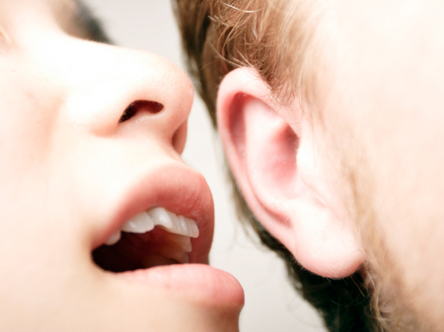
Language plays a powerful role in how concepts of ‘normality’ are fashioned and people’s subjectivities or identities are positioned.
Mediators can fall into the trap of categorising or labelling their clients and their problems in ways that reify and reinforce the power and/or knowledge of the mediator and the dominant cultural view

Slide 21

Stories and language mediate, shape, and create our ‘truths’ or realities. Narrative mediators recognise that there is no universal ‘truth’ - there are many different ‘truths’, knowledges or views of the world.
No one story is true and out of the complexity of different stories can emerge a range of possible future stories.
The mediator works with the parties to increase understanding of each other’s truths and to find ways to create an alternative but plausible story that makes sense to all of the participants.

Slide 22
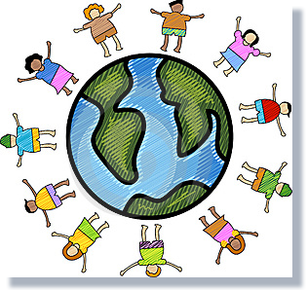
Culture and mediation
Many definitions of mediation still refer to the need for the
third party to be ‘neutral’, ignoring the potential for mediation to perpetuate racism, power and privilege.

Slide 23
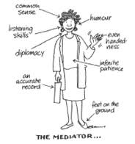
Mediators in a postmodern world
The so-called ‘neutrality’ or ‘objectivity’ or our professional practices as mediators has been questioned

Slide 24
Is it possible to be ‘neutral’ or ‘objective’?
Professional practices can
manufacture a colonising
discourse of the ‘other’ under
the veil or guise of ‘neutrality’
or ‘objectivity’
Representations of ‘self’ and
‘other’ are always situated
politically and historically

Slide 25
Self-reflexivity and mediation
Self-reflexivity is based on the premise that ‘knowledge cannot be separated from the knower’ .
Our presence as mediators, in whatever form, will have some kind of effect, or influence on what we ‘know’ or our ‘truths’.
This means the mediator should be aware of his/her effect on the process and outcomes of mediation.
Definition: ‘Turning-back of one’s experience upon oneself and being conscious of ourselves as we see ourselves’ (Steier)

Slide 26
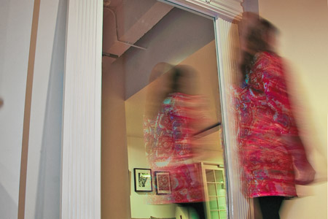
Self-reflexivity
Involves making visible the personal biases and cultural, political and social influences which impact on our ability to be a ‘neutral’ & ‘impartial’ mediator.

Slide 27
Self-reflexivity requires mediators to ..
recognise that their practices are culturally specific, not ‘neutral’
be explicit about the operation of power and mindful of their position in the mediation process
assume a non-hierarchical position (‘bottom up’ rather then ‘top down’)
work collaboratively with clients in a collegial, partnership role
privilege the clients’ knowledge, interpretations, meaning of events, world views and assist them to open up to alternative views, meanings etc

Slide 28
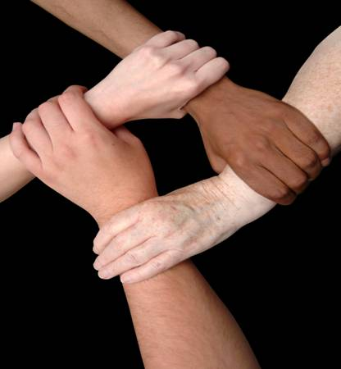
The Importance of Culture (LeBaron)
All conflicts are culturally based
Cultures are fluid and changing continually
Cultures are constructed from deeply shared meanings
Each person is a part of many cultures
There is wide variation within cultures

Slide 29
Mediators need to be culturally fluent
Cultural fluency = ‘developing mindful awareness by reflecting on our own cultural ways of knowing and being’.
‘Recognizing that cultures are constructed from deeply shared meanings, that each individual is a part of multiple cultures, and there is wide variation within cultures, the aspiration to design culturally appropriate processes is seen in its true complexity’.
Michelle LeBaron

Slide 30
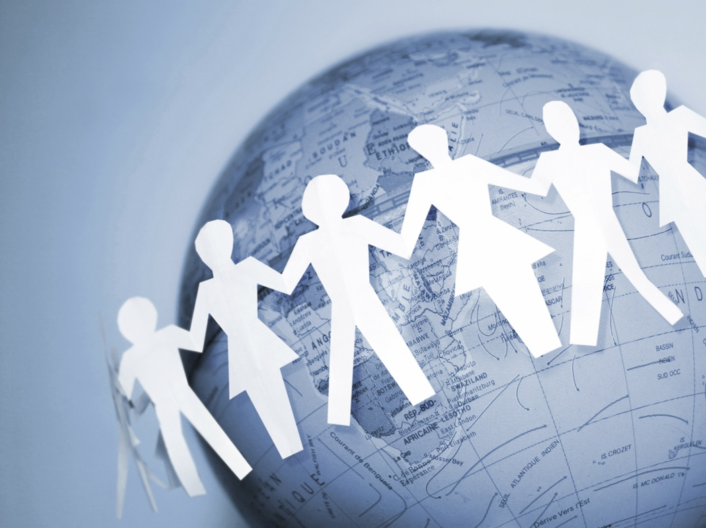
Broader structural challenges
Mediators must pay attention to broader structural issues of:
Power
Justice
Human rights

Slide 31
The issue of power should always be a major consideration in mediation
Dominant Western models of mediation
presuppose a roughly equal balance of
power between the parties and rarely
take into account the power inherent
in the dominant discourses in a
culture nor the structural
(e.g. economic, gendered) inequities
in the broader social context.

Slide 32
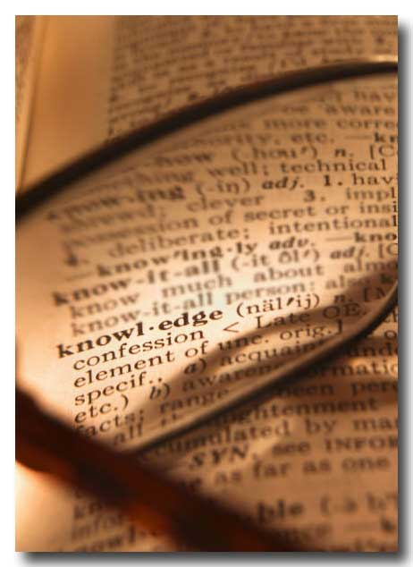
Michelle Foucault, the French philosopher, highlighted how dominant discourses in a culture have the power to determine what counts as knowledge or ‘truth’ and what does not, whose voices are dominant and whose voices are marginalised, subordinated or silenced.

Slide 33
Critics have worried about mediators ignoring structural inequities and allowing effective negotiators to violate the rights of weaker parties
When mediators are not aware of, or fail to deal with, power imbalances, or abuses of power, these imbalances and abuses are sanctioned and reproduced – mediation then becomes the method of entrenching dominant power structures, not a forum where diverse voices can be heard.

Slide 34
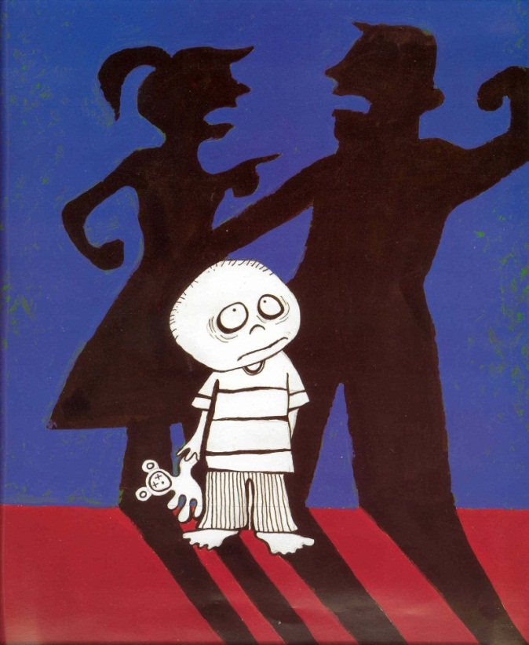
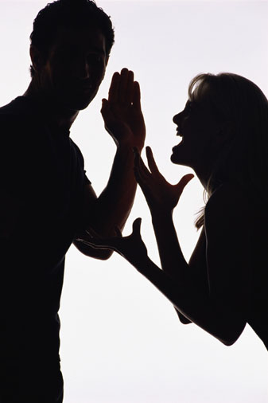
Mediators must recognise and explicitly address abuses of power, human rights and social justice for long term peacebuilding to occur
For example, ignoring the social, cultural, political and gendered context of family mediation where there is family violence is to leave violence unchallenged.

Slide 35
The process of ‘othering’
The colonial legacy is evident in many countries (Indonesia, Australia, Africa, NZ, Papua New Guinea, Fiji, the Philippines, South America etc) and has tended to ignore, marginalise or subordinate Indigenous knowledges and privilege Western ways of knowing.
This has led to a process which is called ‘othering’, which can impact on our mediation practices when working cross-culturally

Slide 36
Learning from ‘others’
Priority needs to be given to retrieving and reclaiming local epistemologies, customary or ‘folk’ knowledge, with regard to conflict and its resolution; that is,
‘knowledge that ordinary people have about causes and ways to deal with conflict in their particular cultural setting’

Slide 37
Language used when defining what mediators do:
‘Conflict resolution’ promotes the idea that conflict is undesirable and should be stopped
‘Conflict management’ suggests that we can control conflict
‘Conflict transformation’ is more closely linked to peacemaking – addresses longer-term conflicts and structural changes

Slide 38
Mediation as Transformative Peacemaking
“Social conflict is a … phenomenon that transforms events, the relationships in which conflict occurs, and indeed its very creators. It is a necessary element in transformative human construction and reconstruction of social organization and realities …
in other words conflict is seen as a transforming agent for systemic change”
John Paul Lederach

Slide 39
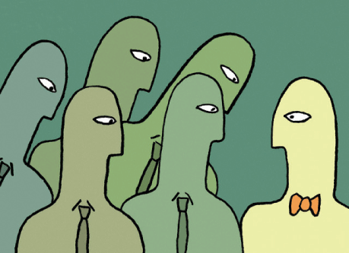
Conflict impacts on people
Personally
Relationally
Structurally
Culturally
Conflict transformation focuses the mediator's attention on the context of conflict and the cultural meanings attached to the complex web and systems of relational patterns.

Slide 40
Transformative peacemaking is based on understanding and a fair, respectful, and inclusive process as a way of life and envisions ‘outcomes’
as a commitment
to
increasing justice,
seeking truth, and
healing relationships

Slide 41
Transformative peace-making
empowers individuals and also nurtures mutuality and community
includes building legal and human rights institutions as well as fair and effective governance and dispute resolution processes and systems
J.P. Lederach

Slide 42
Major challenges for mediators today?
Our construct of ‘peace’ must:
incorporate and value differences and pluralities of identity
recognise our own cultural and situational embededness as interveners
deconstruct and reject discourses on violence and their institutional underpinnings, and
operate within a framework of justice and human rights.

Slide 43
Early intervention and prevention
In order to promote long-term and sustainable peace, our practical objectives must focus on early intervention and prevention through processes such as mediation; and
introduce emancipatory knowledge and promote social transformation in schools, workplaces and other institutions in relation to the legitimation of violence.

Slide 44
Mediation education and training
There is an urgent need to educate and train culturally fluent mediators at every level in our various societies and regions in the world.
It should be a compulsory part of the mainstream curriculum from the first year at school and a pre-requisite for all people in positions of influence, including judges, academics, teachers, religious leaders, CEOs of organisations and politicians.

Slide 45
To summarise …
Mediators in today’s world need to ask the right questions to uncover the nature of social relations, in particular from the perspective of those who are ‘othered’, marginalized or relatively disempowered.
Culturally fluent and self-reflexive mediators are interested in the lived experience of people and place emphasis on allowing people to construct their own identity, process and outcomes within the mediation process

Slide 46
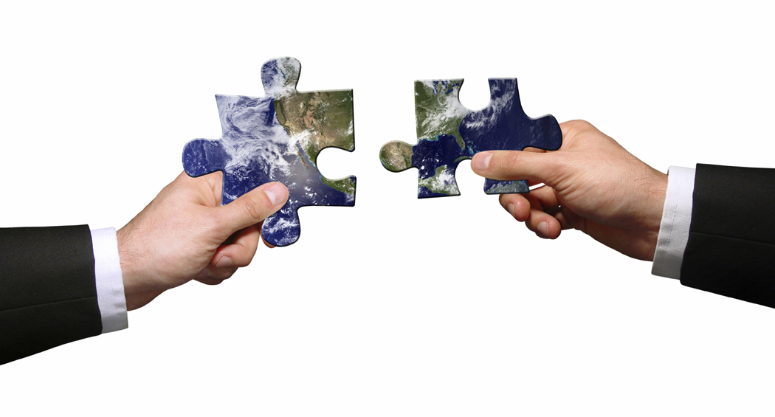
Mediators in today’s world need communication competence in the knowledge that their clients supply the interpretive framework that is necessary for determining appropriate interventions. This means that mediators must:
be client-centred, self-reflexive and culturally fluent
use enabling and empowering ways of working
ensure the inclusion of previously excluded or ‘othered’ voices
accept that tensions and conflicts will be associated with recognition of diverse values and difference and avoid defining themselves and their role as ‘neutral’
allow for a relativity of client needs, within an explicit framework which addresses issues of social justice and human rights.

Slide 47
Finally, there is no one way, or ‘correct’ way to mediate, nor is there a single definition of mediation which will reflect the meanings given to the concept in various cultural groups in the world.
However, mediators as transformative peacemakers need to broaden their constructs of mediation to address the structural changes needed to transform conflicts, uphold human rights and build lasting peace

Slide 48
For more information
Email address:
Dale.Bagshaw@unisa.edu.au
Dale’s University Homepage: http://www.unisanet.unisa.edu.au/staff/homepage.asp?name=dale.bagshaw
Asia Pacific Mediation Forum (APMF) website:
www.asiapacificmediationforum.org

