Slide 2
7th Asia Pacific Mediation Forum: ‘Synergizing Eastern and Western Constructs of Mediation Towards Better Understanding' Lombok, Indonesia, 10-12th February 2016
The Challenges of Inter-Religious Peace-building
in a Post-Conflict Context
Mrs. Laura Coulter –United Mission to Nepal

Slide 3
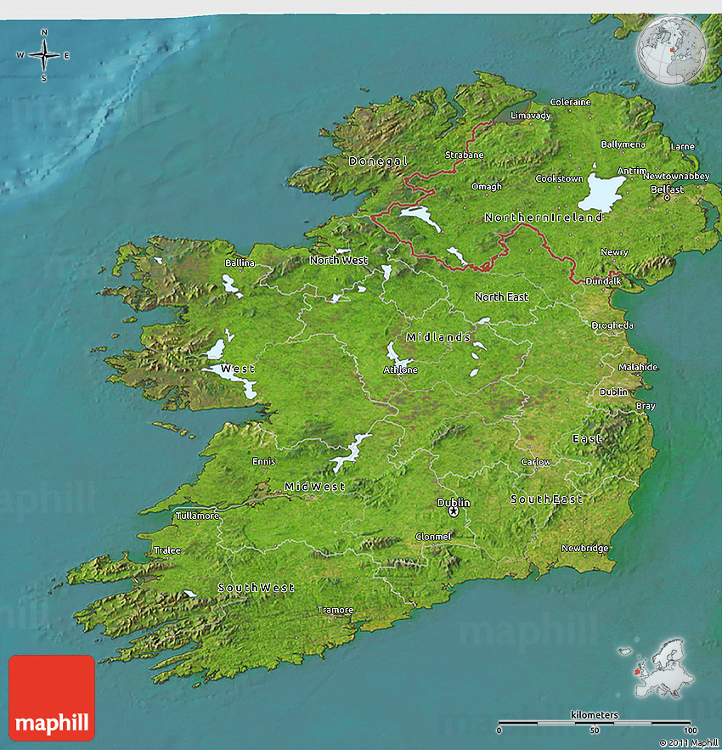
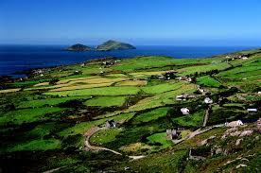
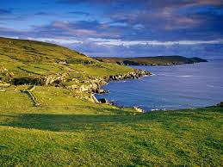
Northern Ireland- 1.71 million
Separate from Southern Ireland
Capital –Belfast
Nationalities- British/Irish

Slide 4
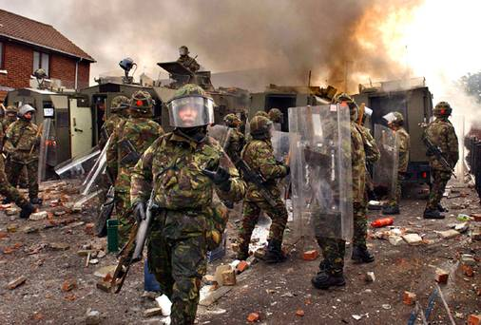
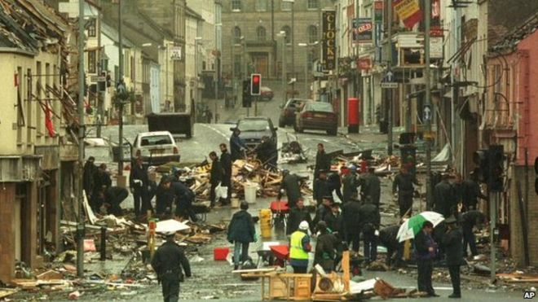
Years of violent conflict 1968-1998 Issue- constitutional status of Northern Ireland Paramilitary groups, loyalist/republican carried out 80% killing British army deployed to keep peace 3,6000 deaths and many injuries, more than 15,000 bombs 1998- Good Friday Peace Agreement signed

Slide 5
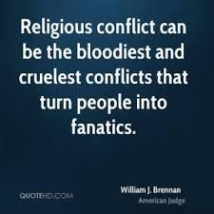
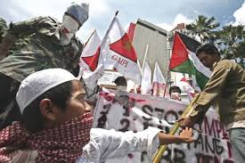
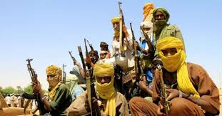
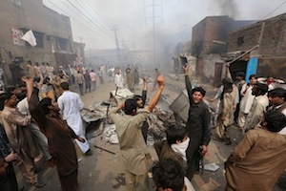
Our world today

Slide 6
Harnessing Religion’s Potential for Peace
Global Covenant
‘a concerted international
response is needed to prevent
and reduce religion related
violence and to increase
regional stability and
community resilience’

Slide 7
The value of Inter-faith Dialogue: how it can build a peaceful society……………
Activities that help to accumulate good-will
Water = good-will
Drain- spoilers who use fear/violence to achieve goals

Slide 8
Strategies to promote peaceful co-existence (Horowtiz 2000)
Promotive Strategies
Preventive Approach
Pre-emptive Actions

Slide 9
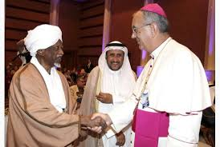
Challenges of Inter-faith Dialogue Aamir Hussain (2014)
lack of focus
Compromise
Proselytizing
Suspicion

Slide 10
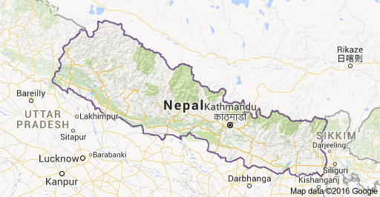
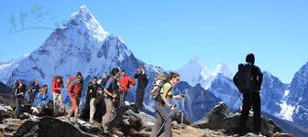
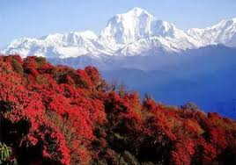
Nepal

Slide 11
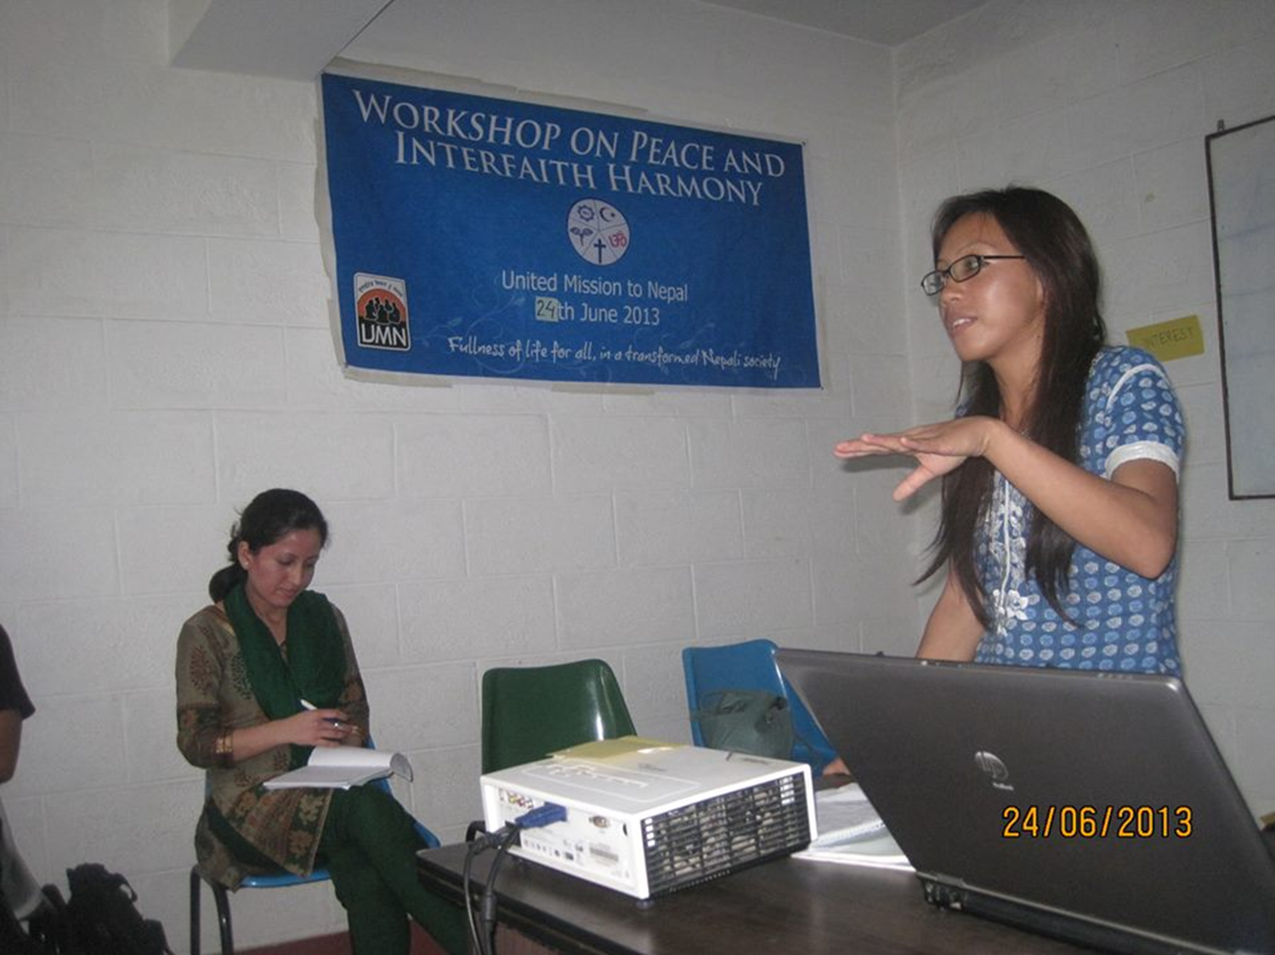
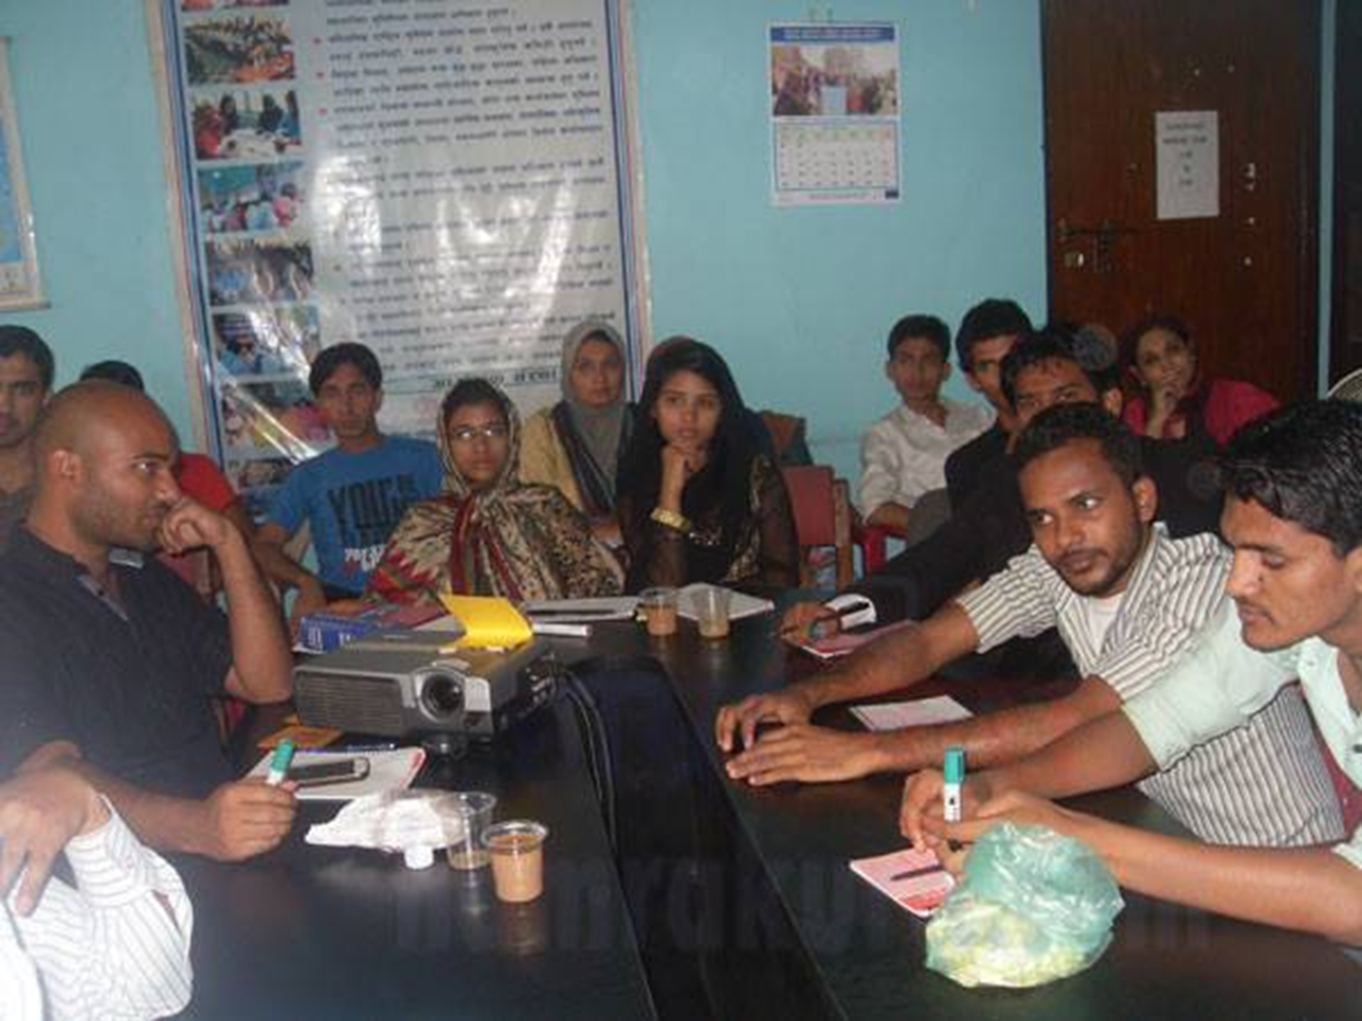
Morang Inter-faith Group

Slide 12
ACTIVITIES
Participation in different religious festivals
Resources to raise awareness
Community peace training
Using media for peace messages
Dialogue between different religious groups
Lobbying government
Peace education to children

Slide 13
Challenges
Working with highly-sensitive issues
Manipulation by one group
Sustainability of the work
Risks/suspicion from others
High expectations v limited resources

Slide 14
‘’Peace is a daily, a weekly, a monthly process, gradually changing opinions, slowly eroding old barriers, quietly building new structures’’ John F. Kennedy

Slide 15
Thanks for Listening!

